Slide 1
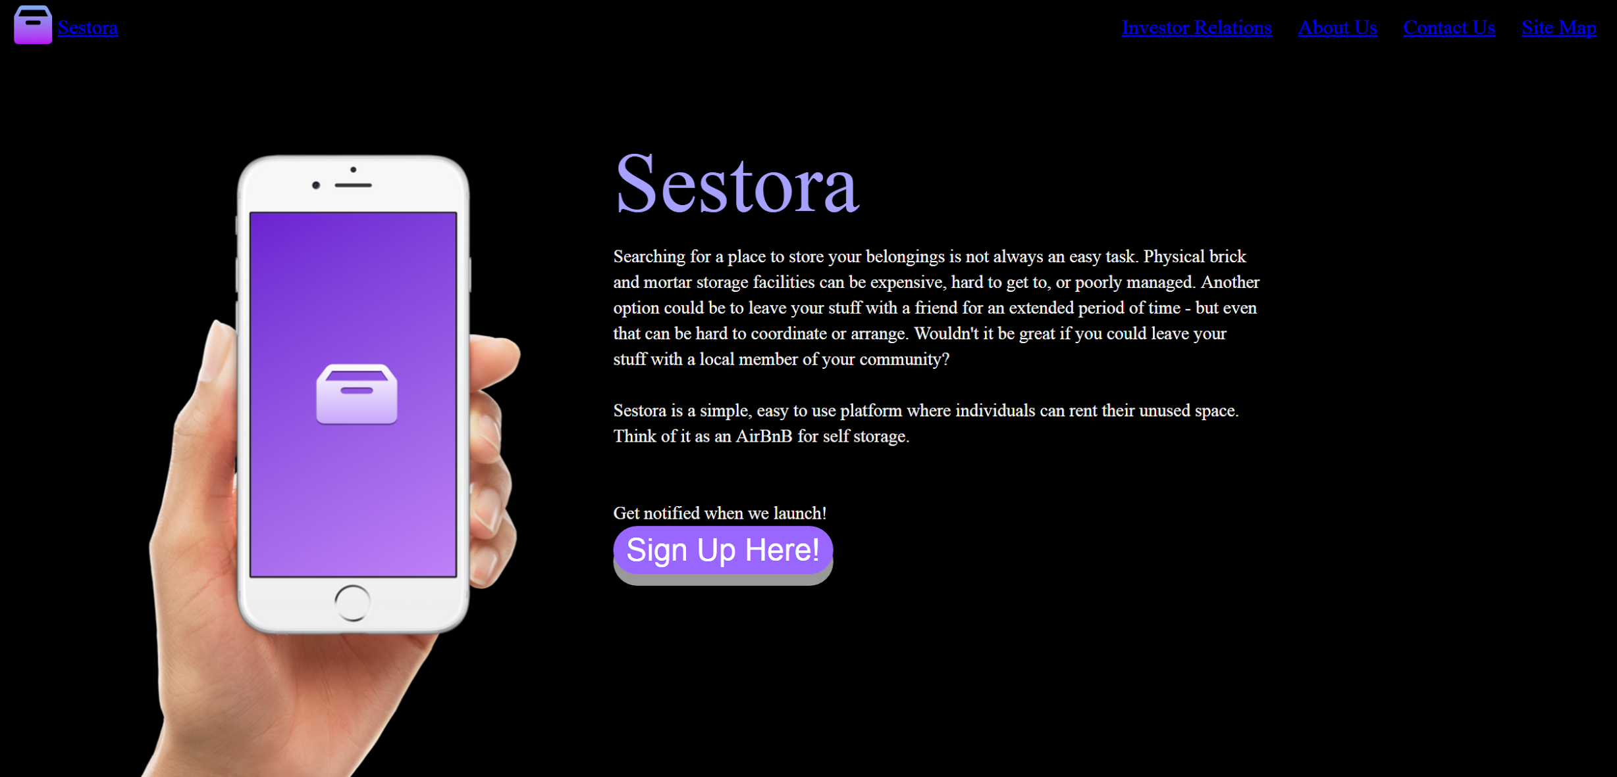
Term Project Review
Hunter, Frankie and Kiley

Slide 2


Our Project
Using Flask: Micro web framework written in Python.
Why Flask over Django?
Flask: like building with Legos – building what you want
Shows how to output to a browser faster than django
Django: building off of a premade model
Faster for Database ORM and to get admin up
Basic Website Design
Develop HTML pages
Mapping with Flask
Determine 1 or 2 backend functions to enhance the project
VS.

Slide 3
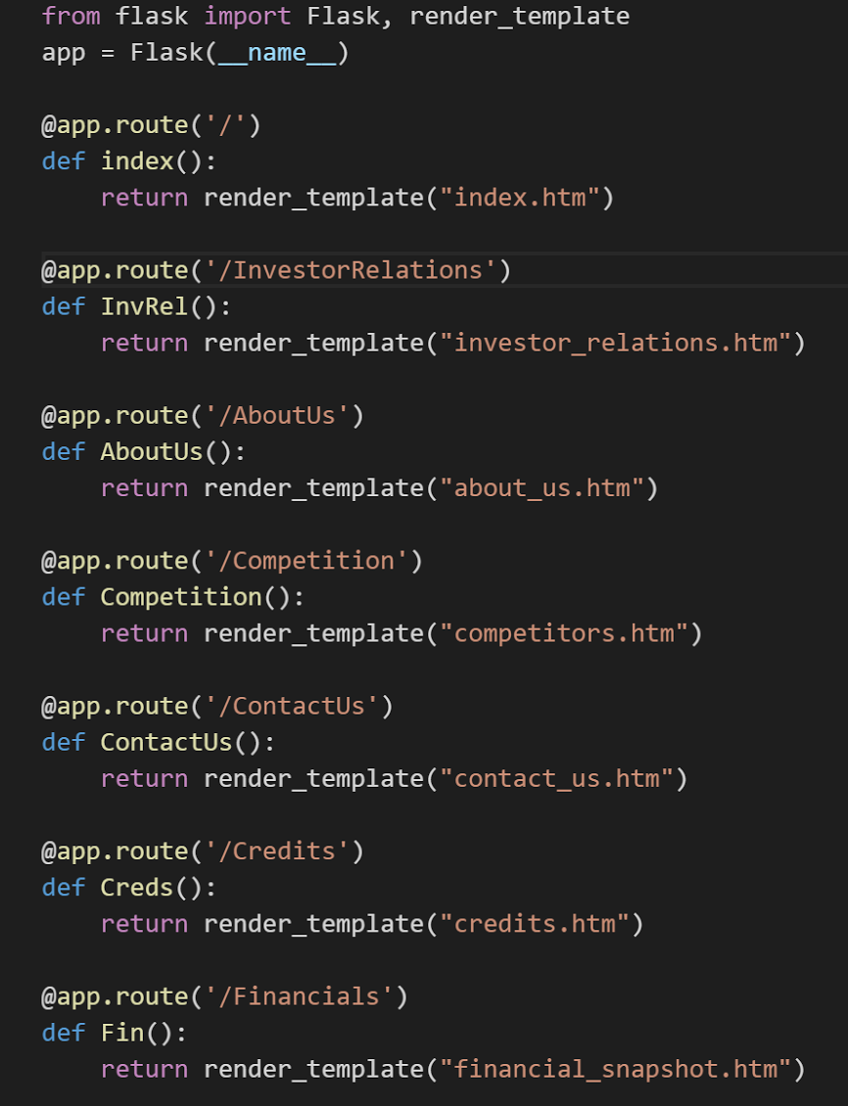

Software Architecture
Our Directory:
Two Files - titled “Static” and “Templates”
HTML Templates → in the “Templates” folder
Images → in the “Static” folder
The ‘main.py’ File:
Contains the bulk of our Python code
Acts as a URL configurator, or map
main.py
File Directory
Snapshot of Home Page

Slide 4

Help Moving Forward
Adding one or two simple backend functions
Assistance with interlinking site pages
Pages run independently
URL not found when clicking through pages

